Slide 1
Reconstruction of 3D Neurovascular Models
Jingyi Zuo, Xuan Peng, Junting Luo

Slide 2
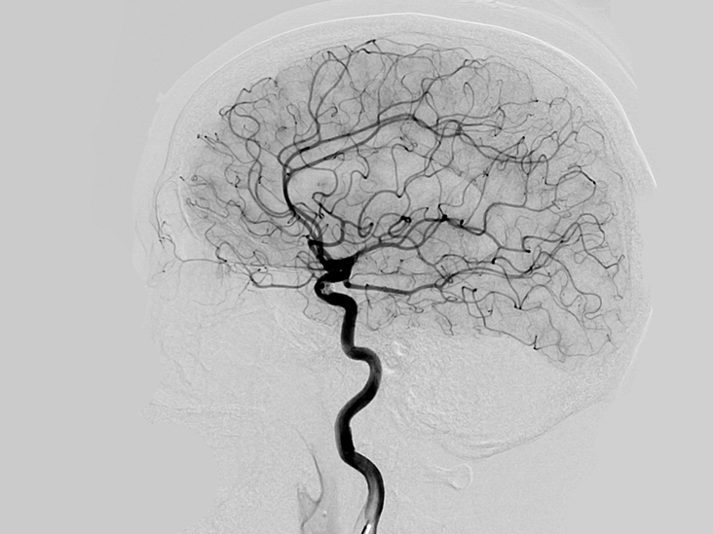
Introduction
People always try to get a clearer view of the internal structure of the human body
Brain vessels are more complex and difficult to reconstruct
During surgery, X-Ray angiography is most efficient, but only 2D images
How can we reconstruct 3D model of brain vessels with only 2D projections as input?

Slide 3
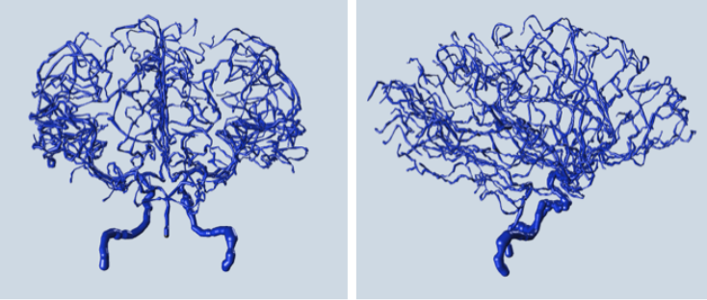
Goal
Reconstruct 3D neurovascular model from only two input projections
Input: two 2D projections of the model captured from different angles
Output: 3D reconstructed model

Slide 4
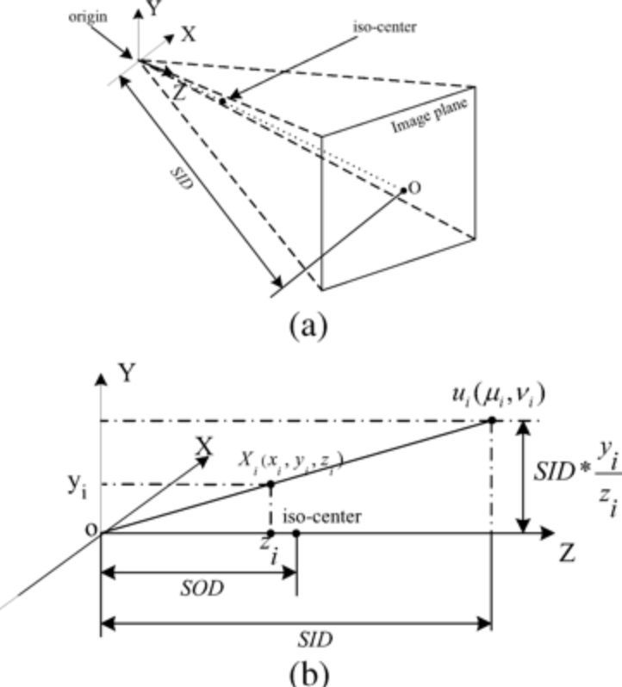
Single Plane Model
High-energy electromagnetic radiation penetrate patient's body and an x-ray image is obtained in different shades of black and white due to the density and absorption differences
In this model, a point in world space is projected to a two-dimension point on the image plane.

Slide 5
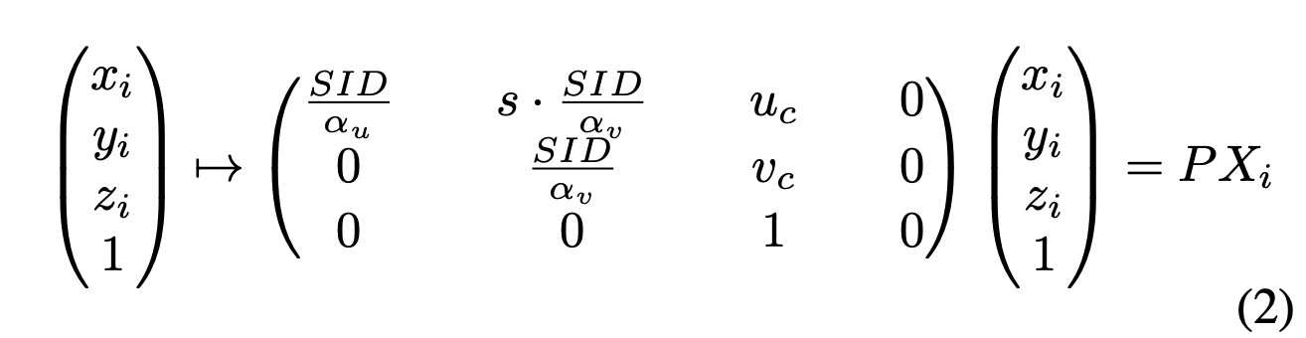
Single Plane Model
SID: Source to image intensifier distance
(uc, vc): Projected coordinate
αu, αv: Image width and height pixels
s: skew parameter

Slide 6
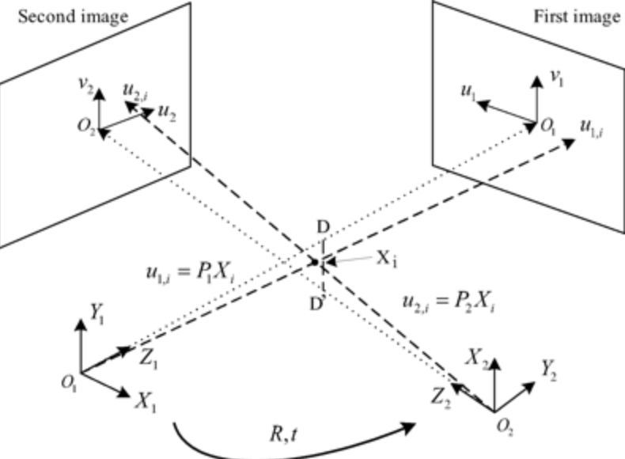
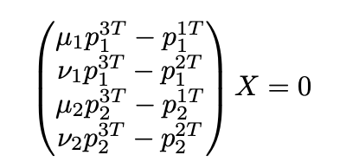
Biplane Model
Biplane reconstruction involves a transformation of camera position which changes the projection matrix, slightly different from single plane model

Slide 7
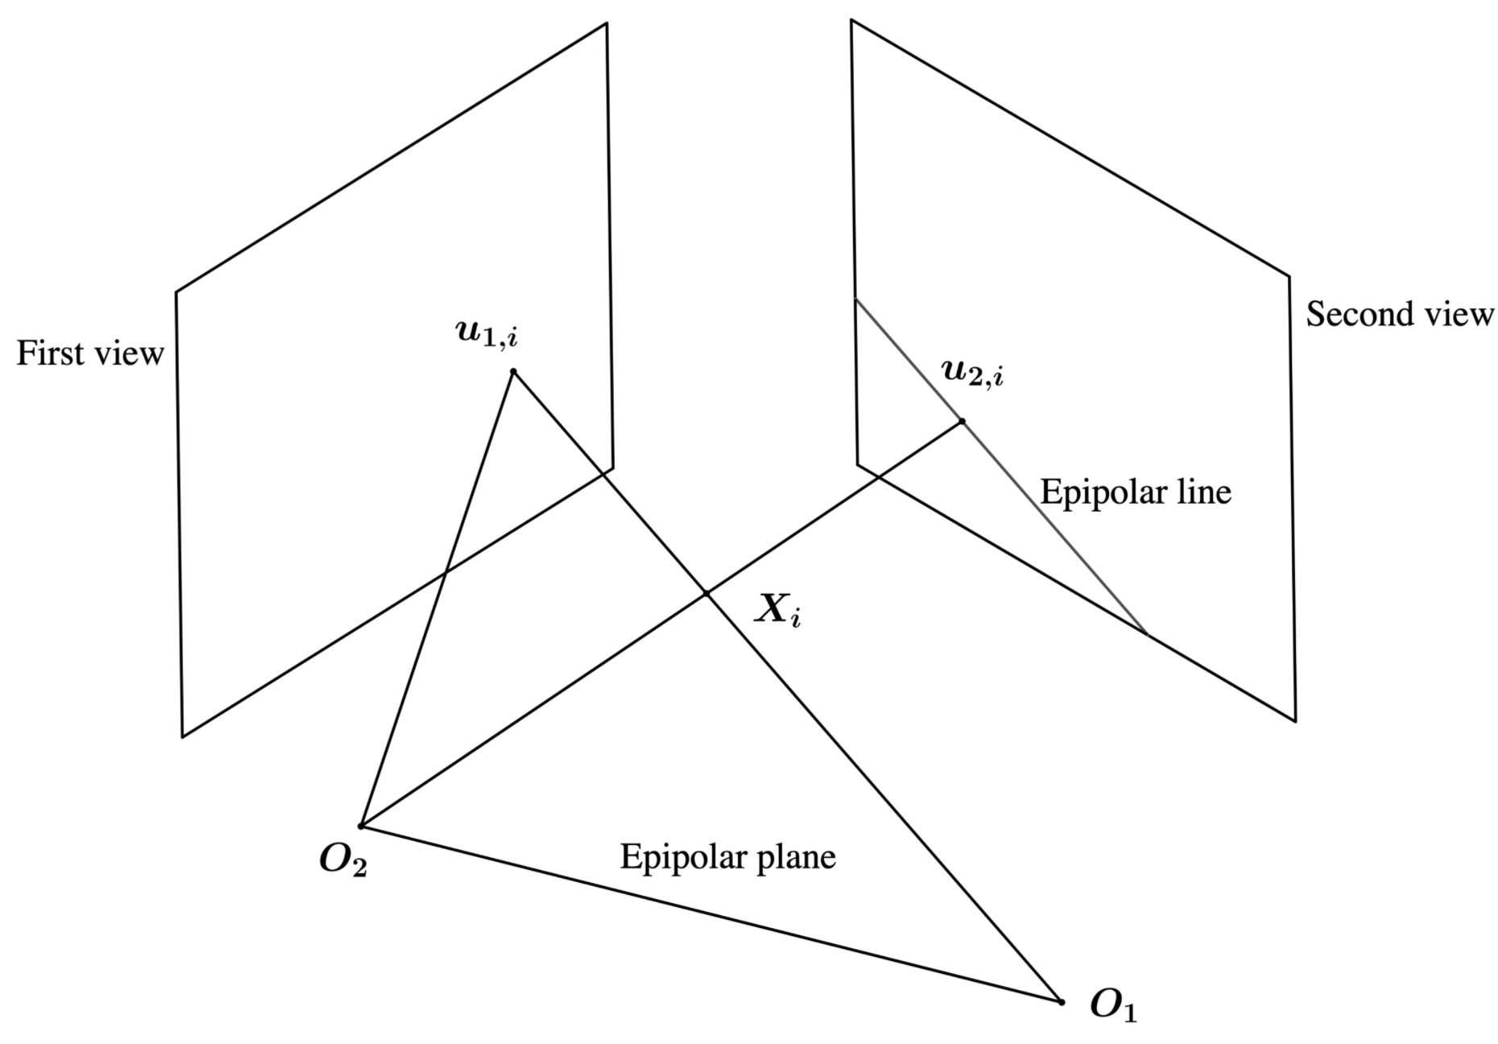
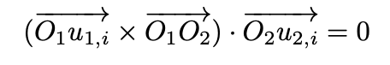
Epipolar Constraint
Epipolar constraint is the restriction relationship between the epipolar plane and the epipolar line, assuming corresponding features are projections from the same three-dimension point

Slide 8
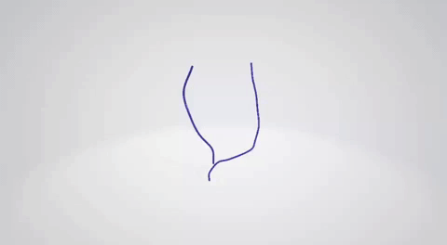
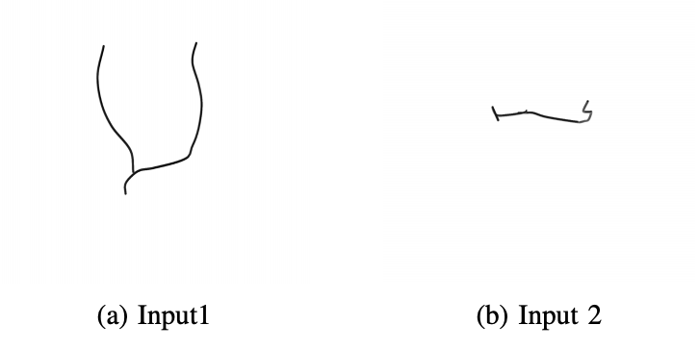
Result on Simple Model
Original model and Input images

Slide 9
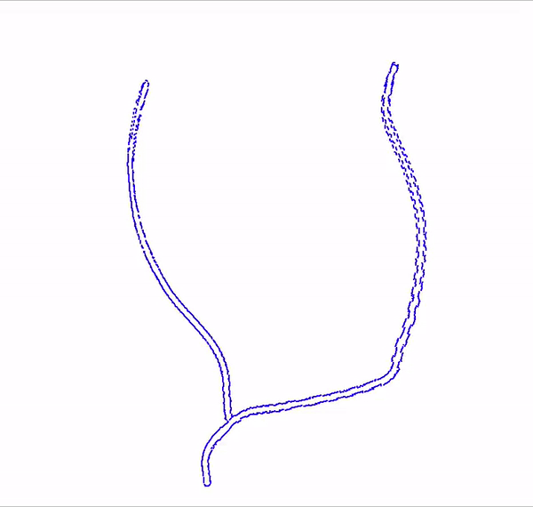
Result on Simple Model
Reconstructed model

Slide 10
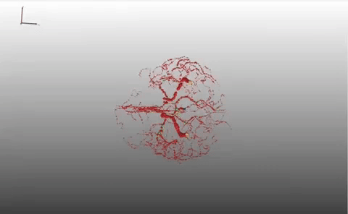
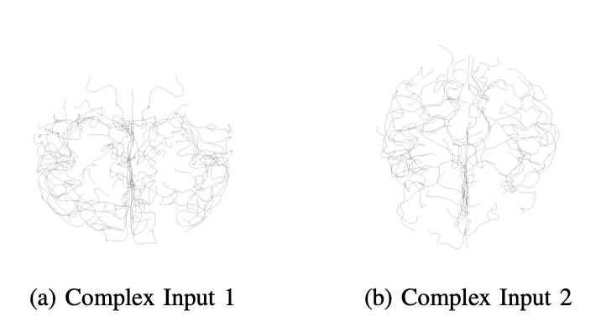
Result on Complex Model

Slide 11
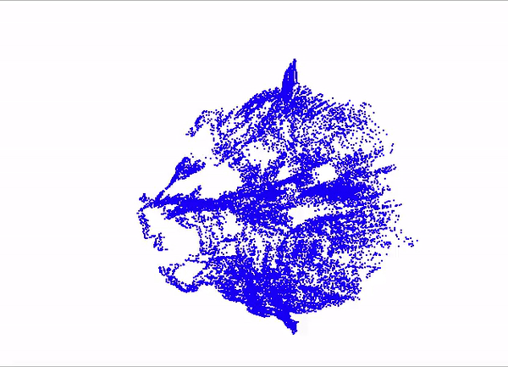
Result on Complex Model
Reconstructed model

Slide 12
Discussion
Problems of this method
Only two input images
Cannot eliminate many noises, not enough input to verify
Manually calibrate input images’ parameters instead of using DICOM files
Inevitable errors from semi-automatic calibration
Future Work
Can apply post-processing techniques to enhance results/remove noises
Optimization algorithms such as Levenberg-Marquardt Algorithm
Frangi filter

Slide 13
Conclusion
Reconstructs 3D model from two view planes
Utilizes stereo image reconstruction techniques(Biplane model + Epipolar constraint)
Results can still be improved by post-processing techniques
Promising performance

Slide 14
References
[1] Y. Furukawa and C. Hernandez. ´ Multi-View Stereo: A Tutorial. 2015. [2] H. Greenspan, M. Laifenfeld, S. Einav, and O. Barnea. Evaluation of center-line extraction algorithms in quantitative coronary angiography. IEEE Transactions on Medical Imaging, 20(9):928–941, 2001. [3] I. K. Hong, S. T. Chung, H. K. Kim, Y. B. Kim, Y. D. Son, and Z. H. Cho. Ultra fast symmetry and simd-based projection-backprojection (ssp) algorithm for 3-d pet image reconstruction. IEEE Transactions on Medical Imaging, 26(6):789–803, 2007. [4] H. Kim, Seung-jun Yang, and Kwanghoon Sohn. 3d reconstruction of stereo images for interaction between real and virtual worlds. In The Second IEEE and ACM International Symposium on Mixed and Augmented Reality, 2003. Proceedings., pages 169–176, 2003. [5] Yan Ke and R. Sukthankar. Pca-sift: a more distinctive representation for local image descriptors. In Proceedings of the 2004 IEEE Computer Society Conference on Computer Vision and Pattern Recognition, 2004. CVPR 2004., volume 2, pages II–II, 2004. [6] J. Yang, Y. Wang, Y. Liu, S. Tang, and W. Chen. Novel approach for 3- d reconstruction of coronary arteries from two uncalibrated angiographic images. IEEE Transactions on Image Processing, 18(7):1563–1572, 2009. [7] Z. Zhang. Determining the epipolar geometry and its uncertainty: A review. International journal of computer vision, 27(2):161–195, 1998. [8] Z. Zhang. A flexible new technique for camera calibration. IEEE Transactions on Pattern Analysis and Machine Intelligence, 22(11):1330– 1334, 2000.

Slide 15
Thank you！

